Slide 1
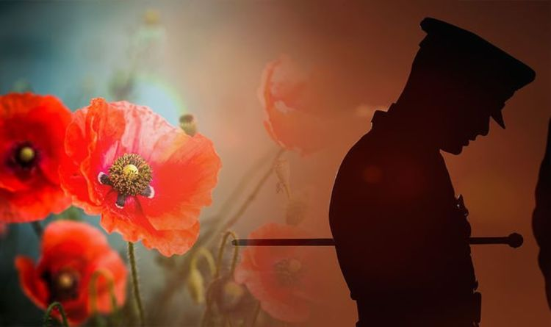
Sunday 12th November
Remembrance Sunday

Slide 2
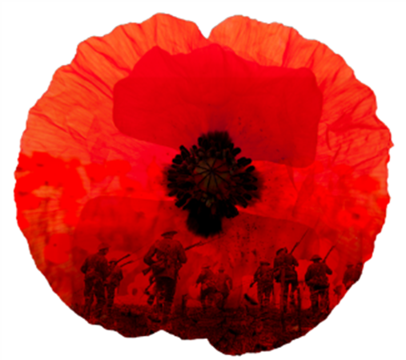

We stand to sing
Gathering Hymn
I Vow to Thee my Country

Slide 3
I vow to thee, my country,
all earthly things above
entire and whole and perfect,
the service of my love:
the love that asks no questions,
the love that stands the test,

Slide 4
that lays upon the altar
the dearest and the best;
the love that never falters,
the love that pays the price,
the love that makes undaunted
the final sacrifice.

Slide 5
And there’s another country
I’ve heard of long ago,
most dear to them that love her,
most great to them that know;
we may not count her armies,
we may not see her King;

Slide 6
her fortress is a faithful heart,
her pride is suffering; and soul by soul and silently her shining bounds increase,
and her ways are ways
of gentleness
and all her paths are peace.

Slide 7
Gathering
In the name of the Father,
and of the Son,
and of the Holy Spirit.
All Amen.

Slide 8
Words of Welcome
Grace, mercy and peace
from God our Father
and the Lord Jesus Christ
be with you
All and also with you.

Slide 9
Norma -Prayers of Penitence
God the Father forgives us in Christ and heals us by the Holy Spirit.
Let us therefore put away all anger and bitterness, all slander and malice,
and confess our sins
to God our redeemer.

Slide 10
All Most merciful God,
Father of our Lord Jesus Christ,
we confess that we have sinned
in thought, word and deed.
We have not loved you with our whole heart.

Slide 11
We have not loved our neighbours
as ourselves.
In your mercy
forgive what we have been,
help us to amend what we are,
and direct what we shall be;

Slide 12
that we may do justly,
love mercy,
and walk humbly with you, our God.
Amen.

Slide 13
Almighty God
Have mercy upon us
Pardon our sins, and bring us to everlasting life.
For the sake of your son,
our Saviour Jesus Christ our Lord.
All Amen.

Slide 14
Collect Prayer for Remembrance Sunday
God, our refuge and strength,
bring near the day when wars shall cease
and poverty and pain shall end,
that earth may know the peace of heaven
through Jesus Christ our Lord.
All Amen.

Slide 15
Reading
Psalm 48
God is our refuge and strength,
an ever-present help in trouble.
Therefore, we will not fear, though the earth give way and the mountains fall into the heart of the sea, though its waters roar and foam and the mountains quake with their surging.

Slide 16
There is a river whose streams make glad the city of God, the holy place where the Most High dwells. God is within her, she will not fall; God will help her at break of day.
Nations are in uproar, kingdoms fall;
he lifts his voice, the earth melts.

Slide 17
He makes wars cease to the ends of the earth.
He breaks the bow and shatters the spear;
he burns the shields with fire.
He says,
“Be still, and know that I am God;

Slide 18
I will be exalted among the nations,
I will be exalted in the earth.”
The LORD Almighty is with us;
the God of Jacob is our fortress.
This is the word of the Lord
All: Thanks be to God

Slide 19
Reading
Isaiah 2: 3-5
“Come, let us go up to the mountain of the Lord, to the temple of the God of Jacob.
He will teach us his ways,
so that we may walk in his paths.”
The law will go out from Zion,
the word of the Lord from Jerusalem.
He will judge between the nations

Slide 20
and will settle disputes for many peoples.
They will beat their swords into plough-shares
and their spears into pruning hooks.
Nation will not take up sword against nation, nor will they train for war anymore.
Come, descendants of Jacob, let us walk in the light of the Lord.
This is the word of the Lord
All: Thanks be to God

Slide 21

Reflection
Roekh Yousaf
Swords into Ploughshares

Slide 22
Creed
Please stand
Let us declare our faith in God.
All We believe in God the Father, from whom every family in heaven and on earth is named.

Slide 23
We believe in God the Son, who lives in our hearts through faith, and fills us with his love.
We believe in God the Holy Spirit, who strengthens us with power from on high.
We believe in one God; Father, Son and Holy Spirit. Amen.

Slide 24
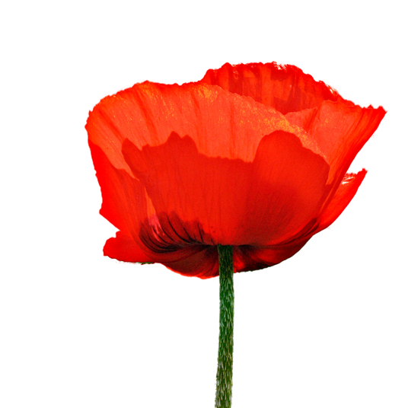
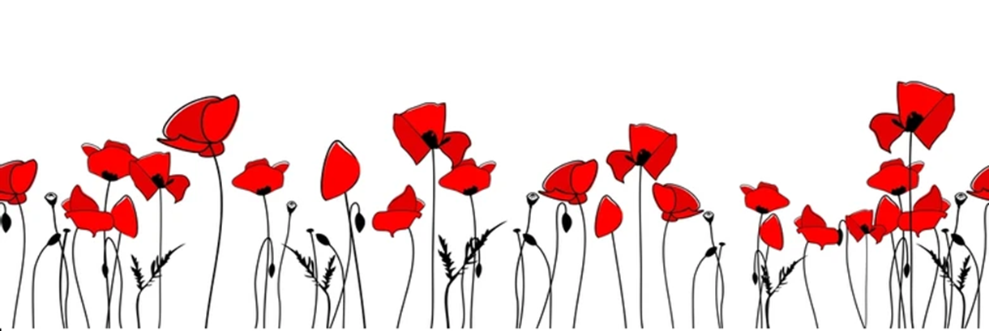

Act of Remembrance
We remain Standing
Last Post will sound
Followed by 2 minutes silence
Reveille

Slide 25
Norma
They went with songs to the battle, they were young,
Straight of limb, true of eye, steady and aglow.
They were staunch to the end against odds uncounted; They fell with their faces to the foe.
All: They shall grow not old, as we that are left grow old: Age shall not weary them, nor the years condemn. At the going down of the sun and in the morning. We will remember them.

Slide 26
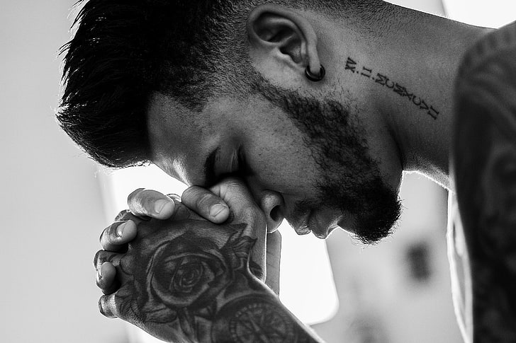
Prayers of Intercession
And at the end
Merciful Father,
All: accept these prayers
for the sake of your Son,
our Saviour Jesus Christ.
Amen.

Slide 27

The Peace
Please stand
Christ came and proclaimed the gospel,
peace to those who are far off and peace to those who are near.
All : and also with you.
Let us offer one another a sign of peace.

Slide 28
We stand to sing
Offertory Hymn
Here is Love

Slide 29


Slide 30
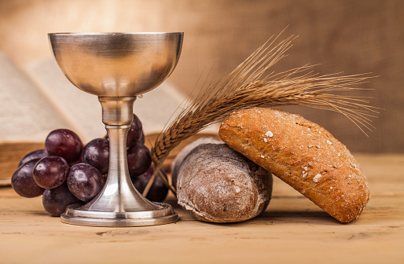
Eucharistic Prayer H
The Lord is here.
All His Spirit is with us.
Lift up your hearts.
All We lift them to the Lord.
Let us give thanks to the Lord our God.
All It is right to give thanks and praise.

Slide 31
It is right to praise you, Father, Lord of all creation;
in your love you made us for yourself.
When we turned away
you did not reject us,
but came to meet us in your Son.
All You embraced us as your children
and welcomed us to sit and eat with you.

Slide 32
In Christ you shared our life
that we might live in him and he in us.
All He opened his arms of love upon the cross
and made for all the perfect sacrifice for sin.
On the night he was betrayed,
at supper with his friends
he took bread, and gave you thanks;
he broke it and gave it to them, saying:

Slide 33
Take, eat; this is my body which is given for you;
do this in remembrance of me.
All Father, we do this in remembrance of him:
his body is the bread of life.
At the end of supper, taking the cup of wine,
he gave you thanks, and said:

Slide 34
Drink this, all of you; this is my blood of
the new covenant,
which is shed for you for the forgiveness of sins;
do this in remembrance of me.
All Father, we do this in remembrance of him:
his blood is shed for all.

Slide 35
As we proclaim his death and celebrate his
rising in glory,
send your Holy Spirit that this bread and this wine
may be to us the body and blood of your dear Son.
All As we eat and drink these holy gifts
make us one in Christ, our risen Lord.

Slide 36
With your whole Church
throughout the world
we offer you this sacrifice of praise
and lift our voice
to join the eternal song of heaven:

Slide 37
Sanctus (Holy holy) ()
We say together
All Holy, holy, holy Lord,
God of power and might,
heaven and earth are full of your glory.
Hosanna in the highest,
Blessed is he who comes
in the name of the Lord.
Hosanna in the highest.

Slide 38
The Lord’s Prayer
As our Saviour taught us, so we pray
All Our Father, who art in heaven, hallowed be thy name; thy kingdom come; thy will be done; on earth as it is in heaven. Give us this day our daily bread.

Slide 39
And forgive us our trespasses, as we forgive those who trespass against us.
And lead us not into temptation; but deliver us from evil. For thine is the kingdom, the power and the glory, for ever and ever. Amen.

Slide 40
Breaking of the Bread
The Minister breaks the consecrated bread.
We break this bread
to share in the body of Christ.
All Though we are many,
we are one body,
because we all share in one bread.

Slide 41
Lamb of God
All Lamb of God, you take away the sins of the world, have mercy on us.
Lamb of God, you take away the sin of the world, have mercy on us.
Lamb of God, you take away the sin of the world, grant us peace.
Congregation Kneels

Slide 42
Norma
Jesus is the Lamb of God
who takes away the sin of the world.
Blessed are those who are called to his supper.
All Lord, I am not worthy to receive you,
but only say the word,
and I shall be healed.

Slide 43
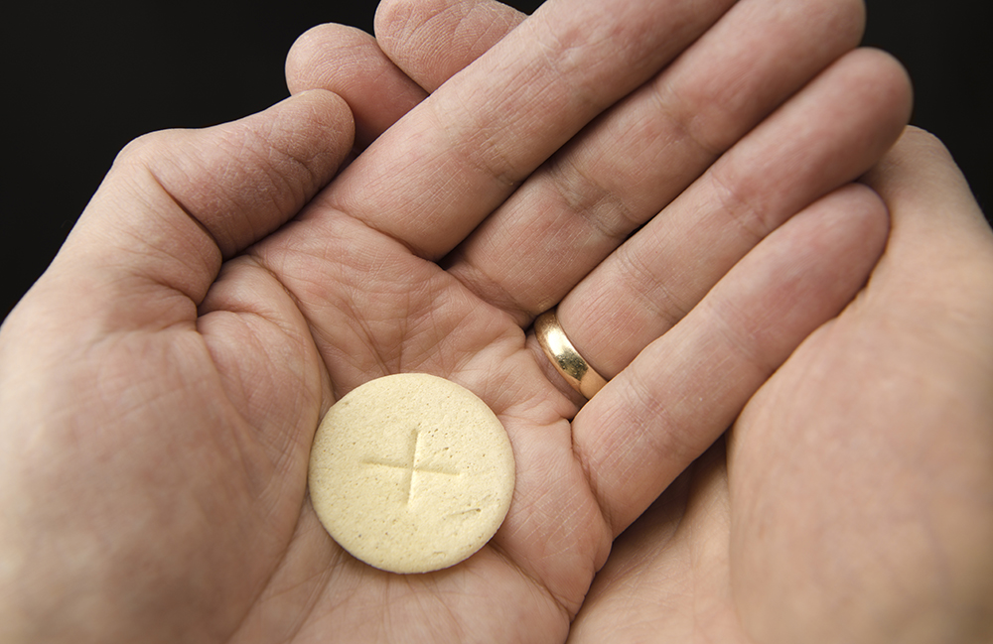
Distribution of Communion

Slide 44
Communion Hymn
Praise to the Almighty

Slide 45
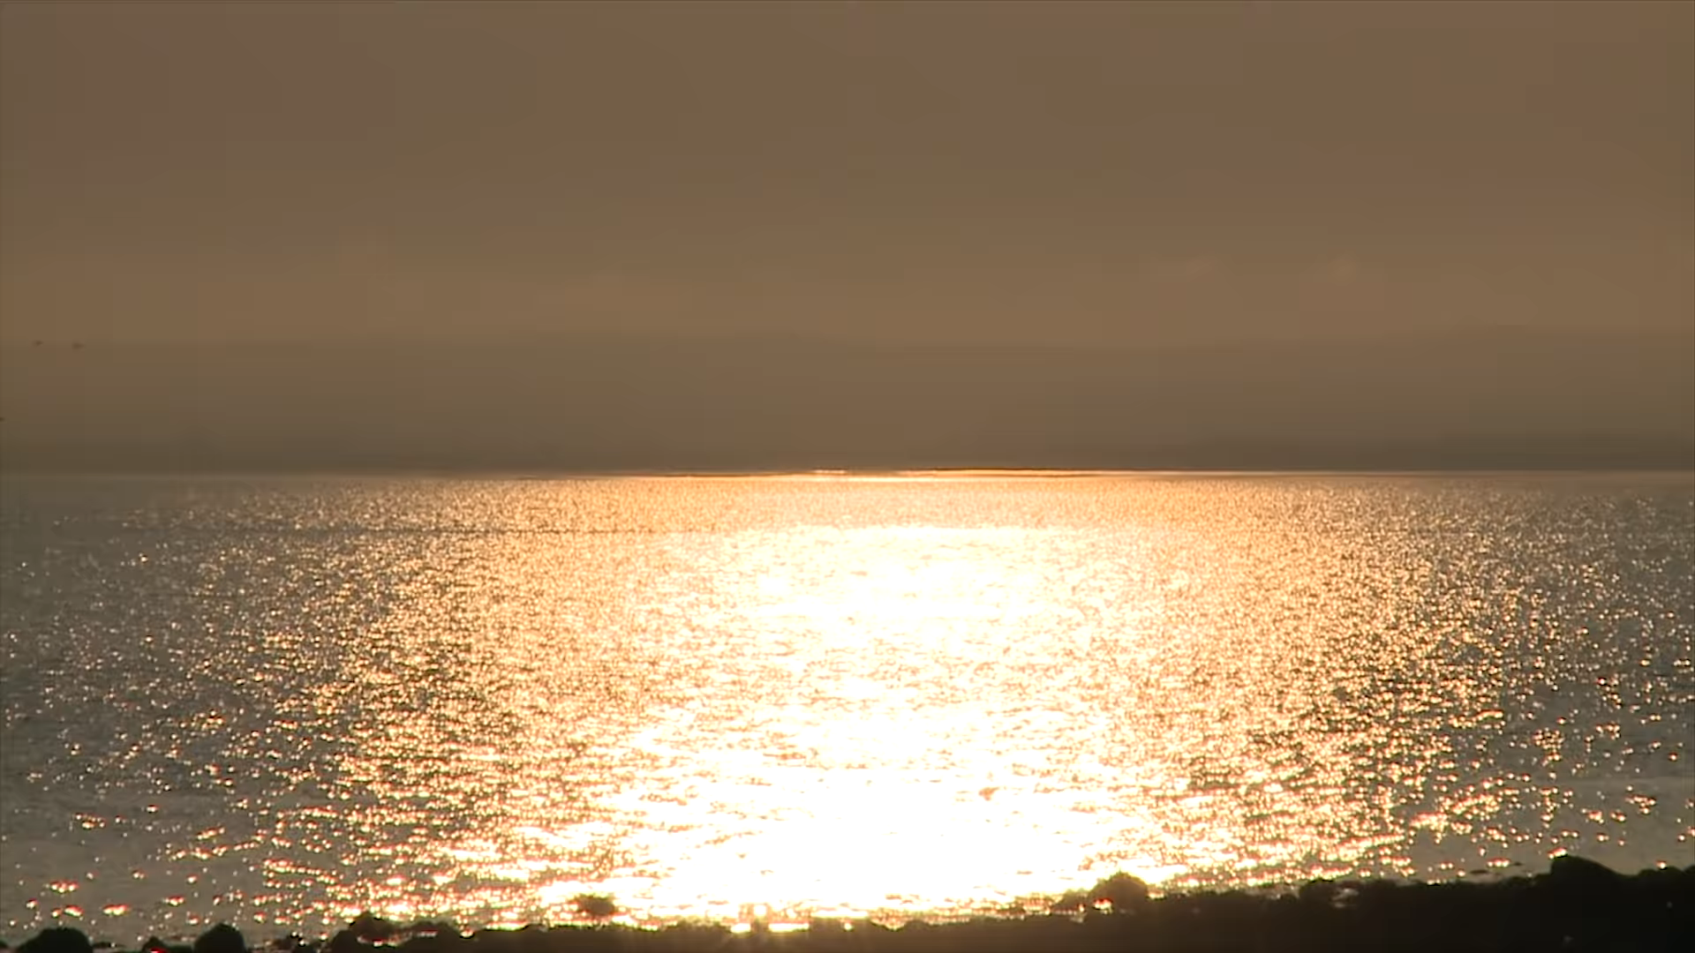

Slide 46
Prayer after Communion
All Almighty God, we thank you for feeding us
with the body and blood of your Son Jesus Christ. Through him we offer you our souls and bodies
to be a living sacrifice. Send us out in the power of your Spirit to live and work to your praise and glory.
Amen.

Slide 47
Post Communion Collect
God of peace,
whose Son Jesus Christ proclaimed the kingdom and restored the broken to wholeness of life: look with compassion on the anguish of the world, and by your healing power
make whole both people and nations;
through our Lord and Saviour Jesus Christ.
All: Amen

Slide 48
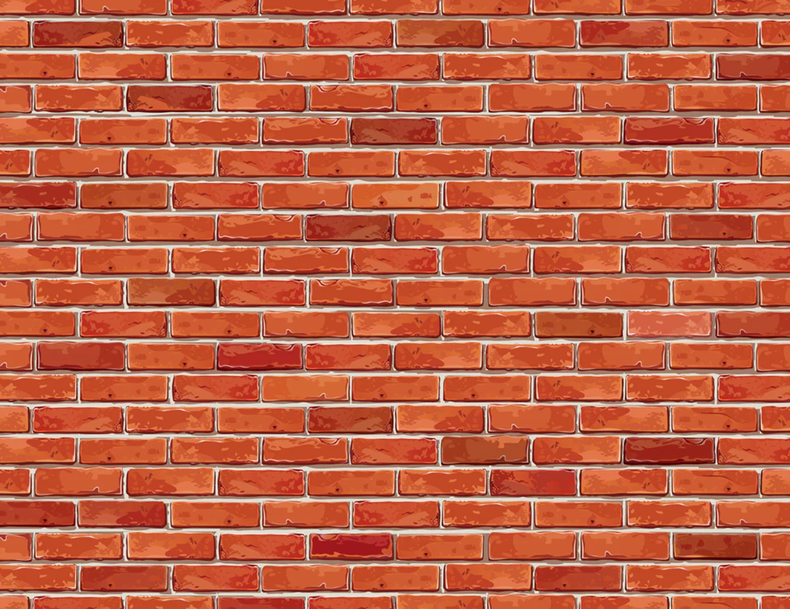


Slide 49
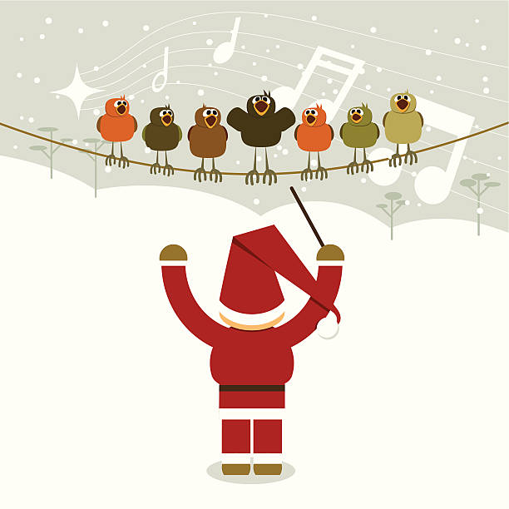


Christmas
Choir
Practice
Tuesdays
at 7pm

Slide 50
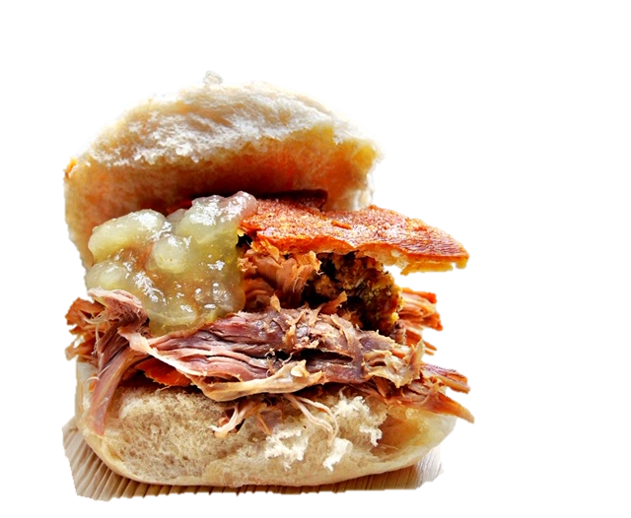



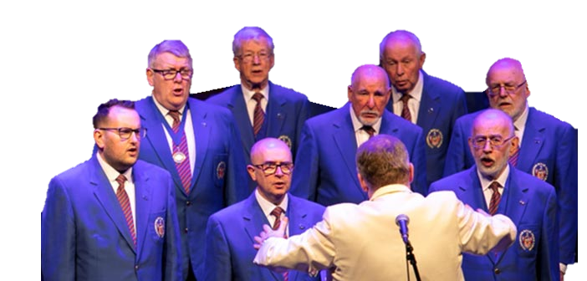
Hog Roast
Thursday 30th Nov
3-4pm -Bishop’s Service
4.30-6.30 Hog Roast
7pm -Free Concert

Slide 51
Final Blessing
May the love of the Father, the tenderness of the Son, and the presence of the Spirit, gladden your heart and bring peace to your soul, this day and every day!
All Amen.

Slide 52

The Dismissal
Norma
Go in peace to love
and serve the Lord
All In the name of
Christ. Amen.

Slide 53
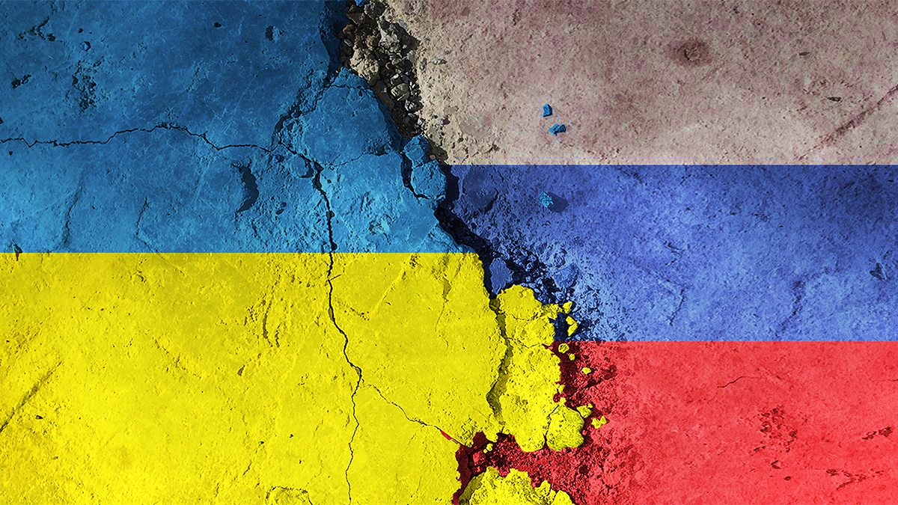
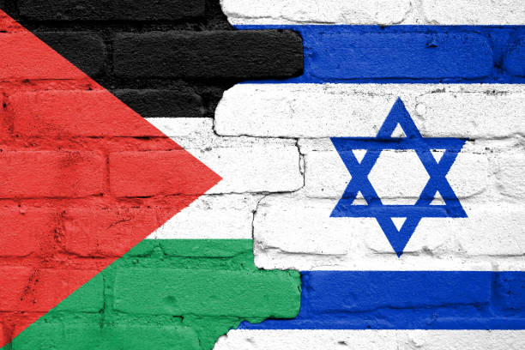
As a mark of Respect for the Dead
we exit in Silence

Slide 54


